Slide 1
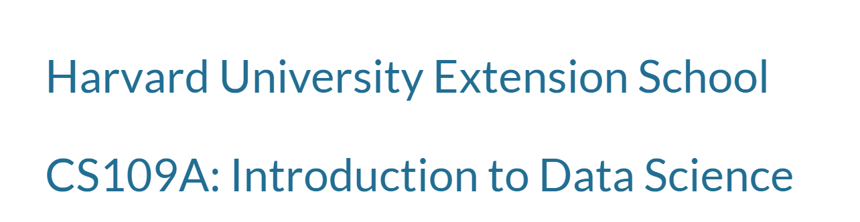
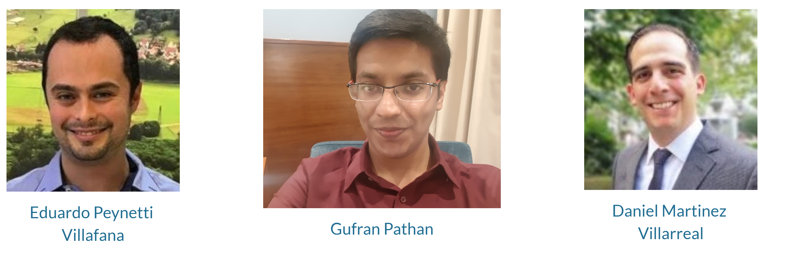
Predicting the impact of Trump’s Tweet on the Financial Market
https://sites.google.com/view/trump-tweets/objectives

